Slide 1
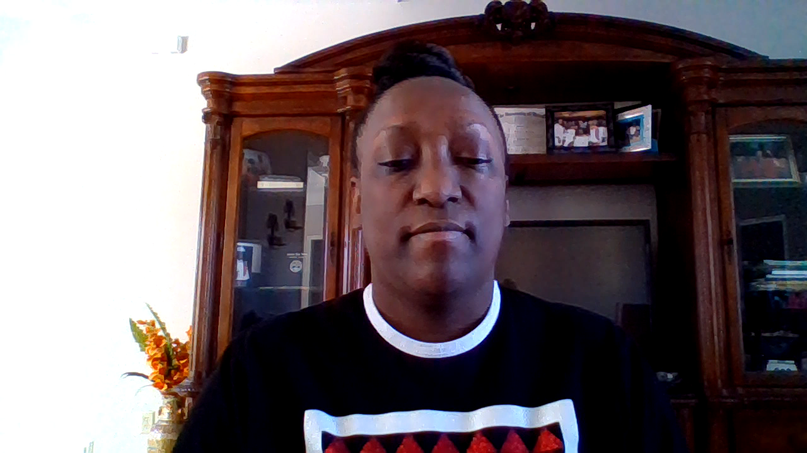
Dr. LeCharle Harris
Assistant Principal (3rd-5th Grade)

Slide 2

Black History Month
Shirley Chisholm

Slide 3
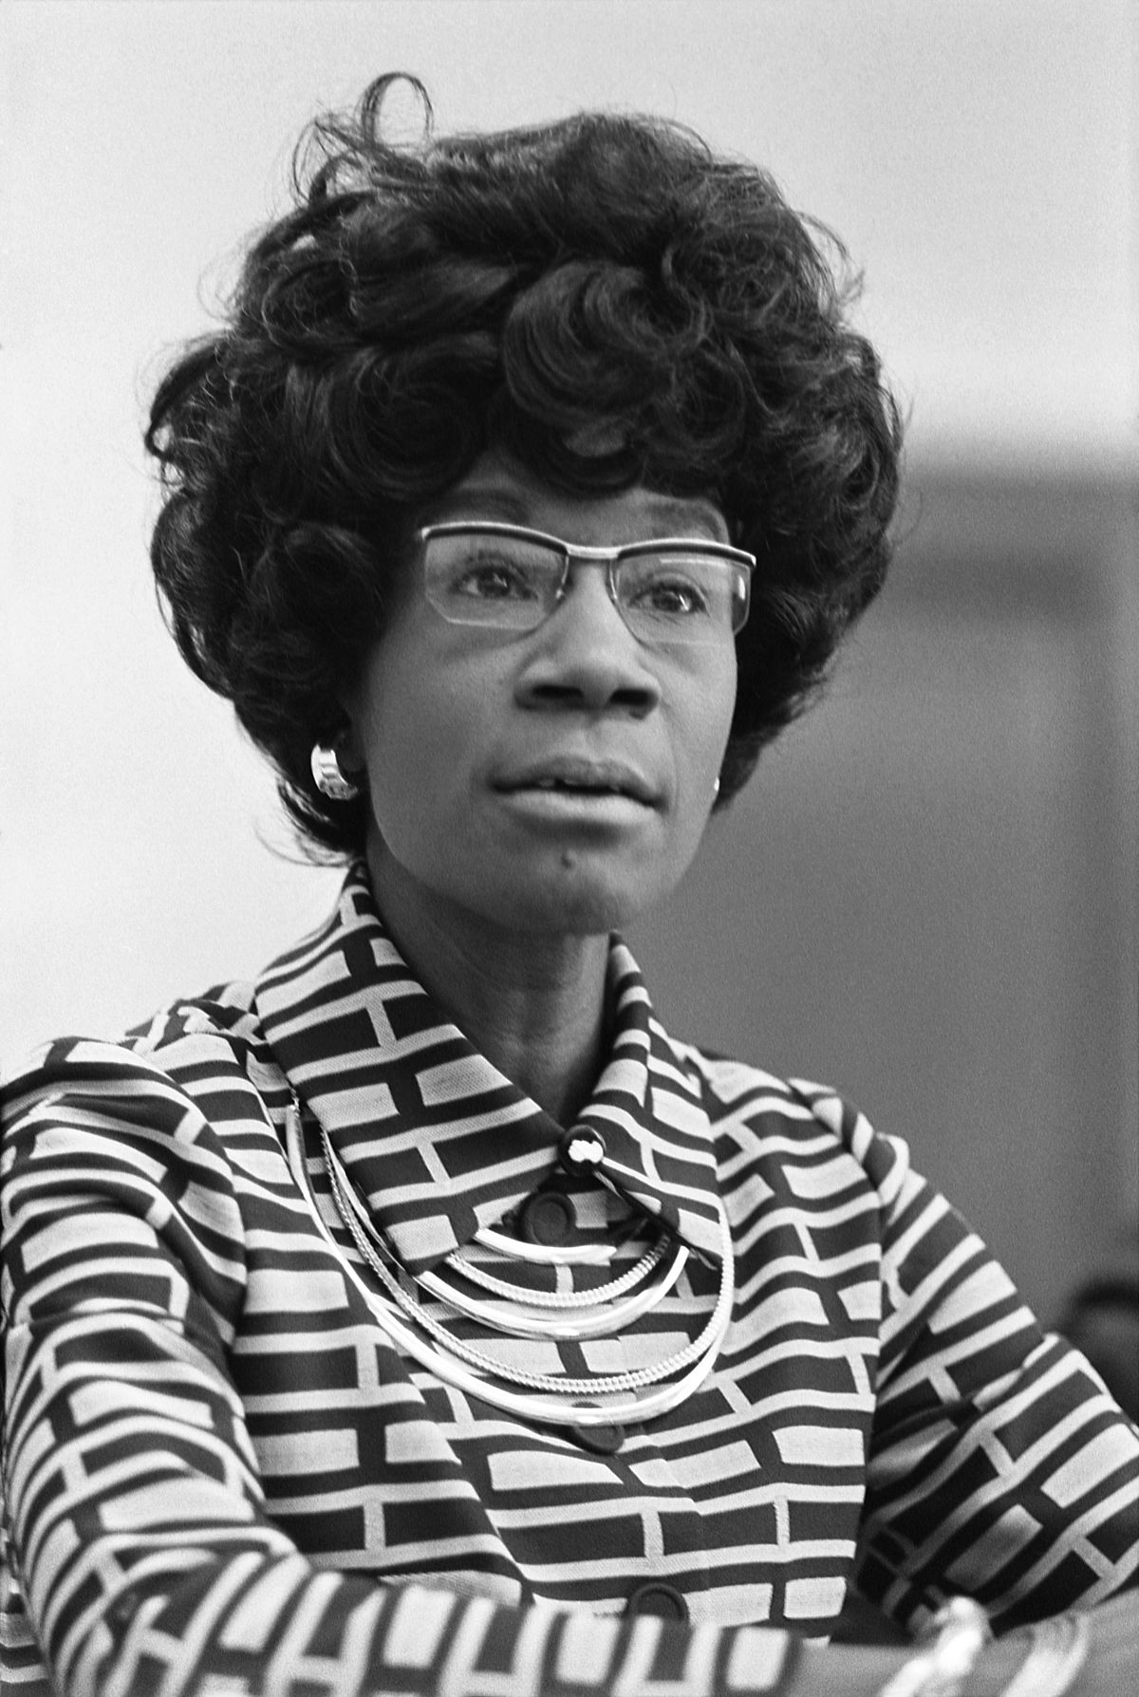
Shirley
Chisholm
(1924-2005)

Slide 4
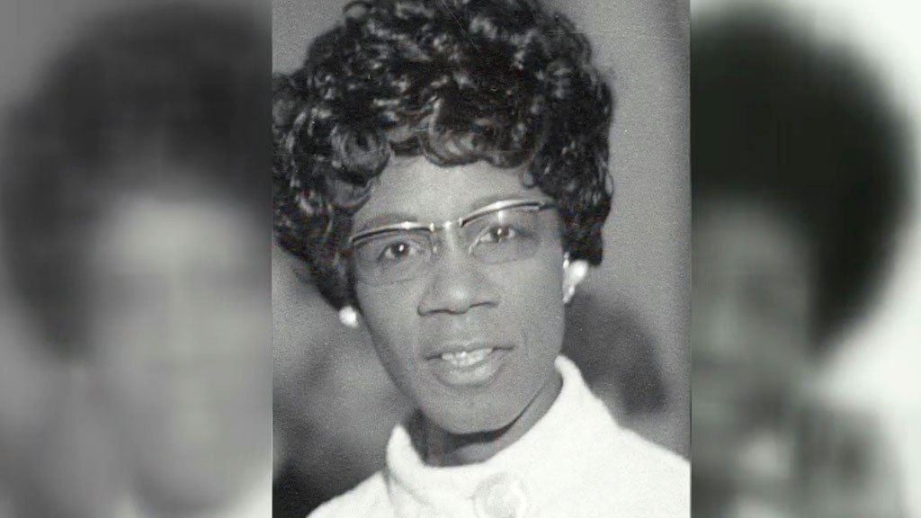
This Photo by Unknown Author is licensed under CC BY
Shirley Anita St. Hill Chisholm was the first African American woman in Congress (1968) and the first woman and African American to seek the nomination for president of the United States from one of the two major political parties (1972).

Slide 5
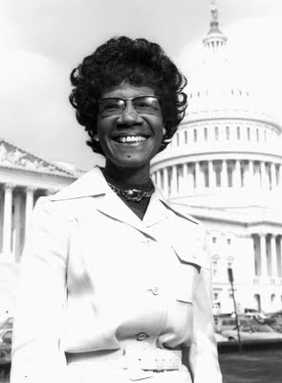
Born in Brooklyn, New York (11-30-1924), Chisholm was the oldest of four daughters to immigrant parents. She graduated from Brooklyn Girls’ High in 1942 and Brooklyn College cum laude in 1946, where she won prizes on the debate team.
Professors encouraged her to consider a political career, she replied that she faced a “double handicap” as both Black & female.

Slide 6
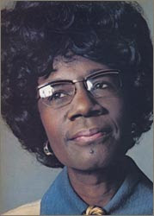
Initially, Chisholm worked as a nursery school teacher. She earned a master’s degree from Columbia University in early childhood education. By 1960 she was a consultant to the New York City Division of Day Care.

Slide 7
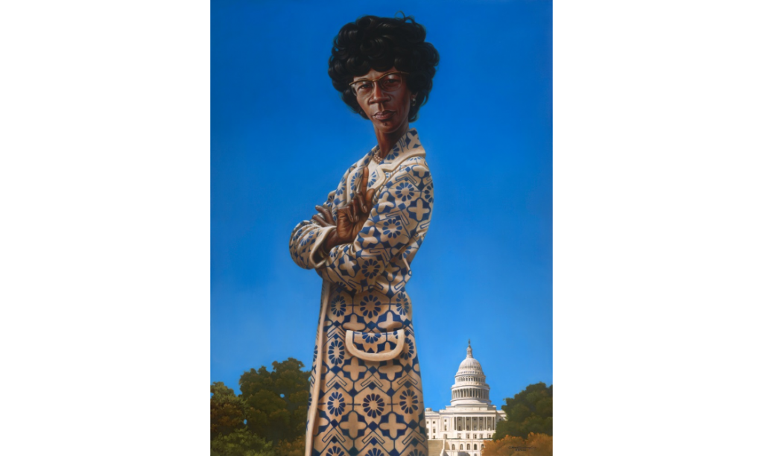
Ever aware of racial and gender inequality as a member of Delta Sigma Theta Sorority, Inc., she joined local chapters of the League of Women Voters, the National Association of Advancement of Colored People (NAACP), the Urban League, as well as the Democratic Party club in Brooklyn.

Slide 8
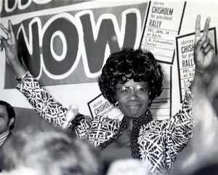
In 1964, Chisolm ran for and became the second African American in the New York State Legislature. In 1968, she sought and won a seat in Congress. She was co-founder of the National Women’s Political Caucus in 1971. In 1972, discrimination followed Chisholm’s quest for the 1972 Democratic Party presidential nomination. She entered 12 primaries and garnered 152 of the delegates’ votes (10% of the total).
Chisholm retired from Congress in 1983. Of her legacy, Chisholm said,
“I want to be remembered as a woman … who dared to be a catalyst of change.”

Slide 9
